Slide 1
Variation and Repeats in UCSC Genome Browser
김형용

Slide 2
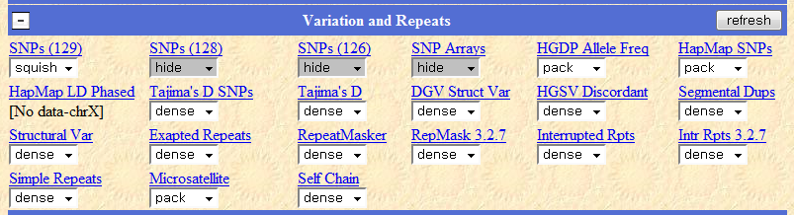

Slide 3
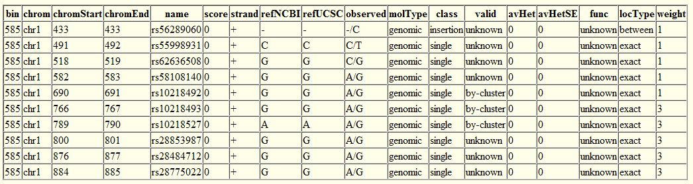
dbSNP
Build 129, 128, 127
Class : Single, In-del, Heterozygous, MS
Validation : Frequency, Cluster, HapMap

Slide 4
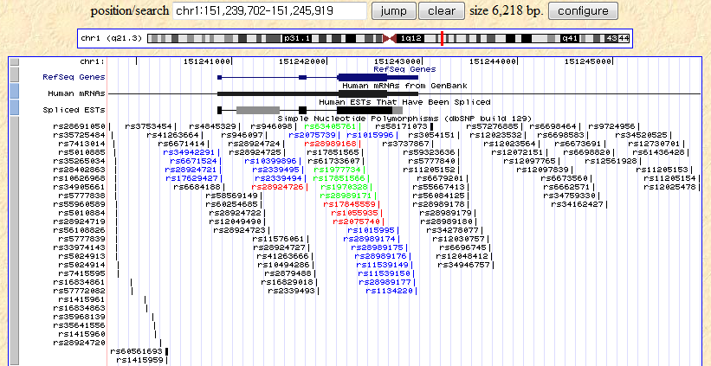

Slide 5
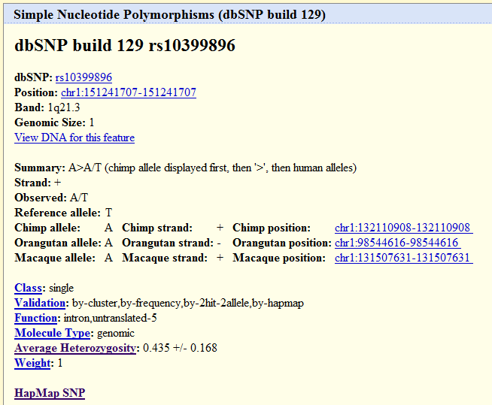

Slide 6
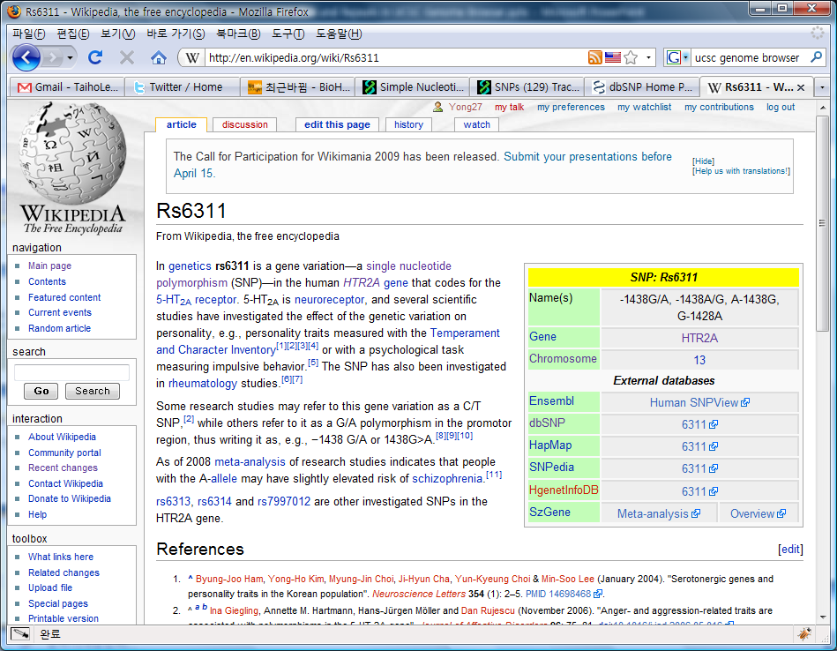

Slide 8
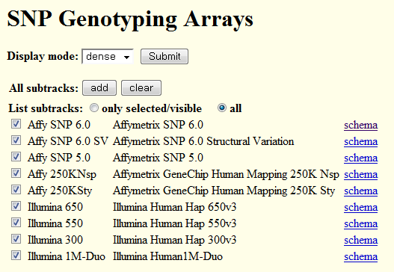
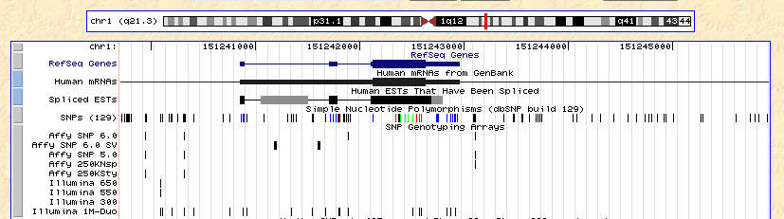

Slide 10
Human Genome Diversity Project SNP
Population Allele Frequencies
657,000 SNPs genotyped in 53 populations worldwide
(Not Korea)
using the Illumina BeadStation

Slide 11
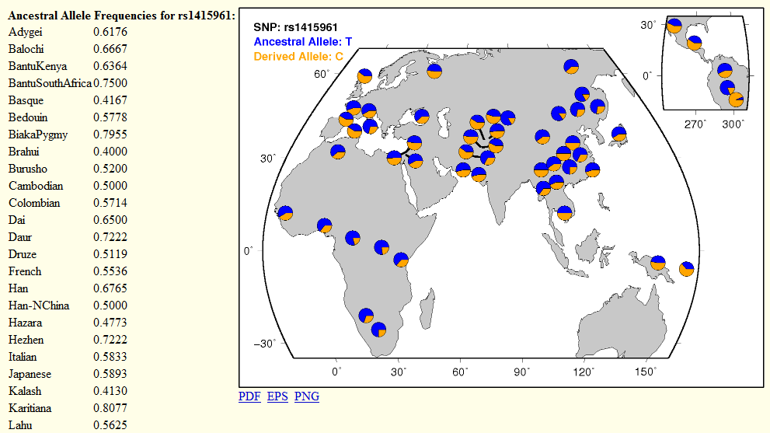

Slide 13
HapMap SNPs
4M SNP typing in 4(11) populations
Reference for future study on human disease
CEU, CHB, JPT, YRI → ASW, CHD, GIH, LWK, MEX, MKK, TSI

Slide 14
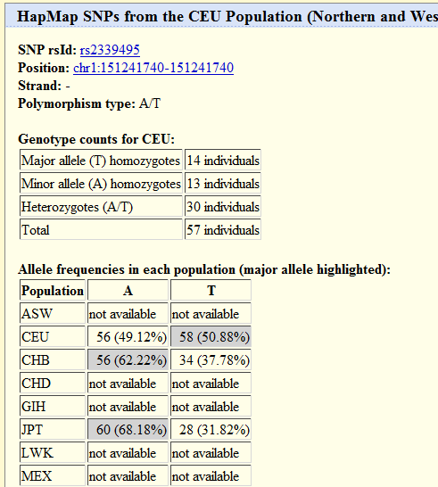

Slide 15
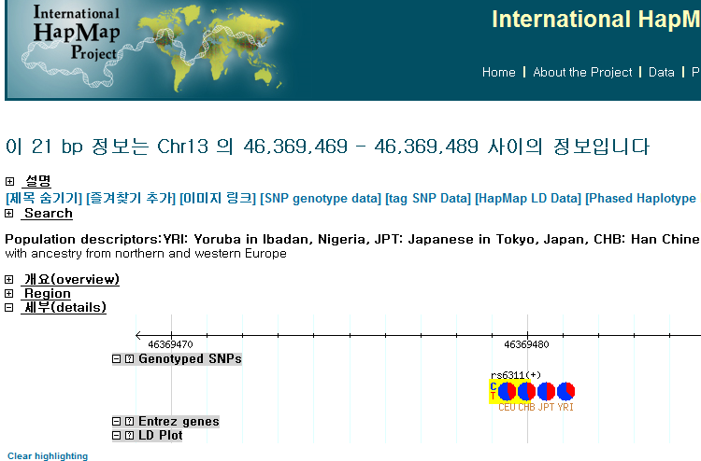

Slide 17
HapMap Linkage Disequilibrium
Association of alleles
Low LD, two loci tend to be inherited in a nearly random manner.

Slide 18
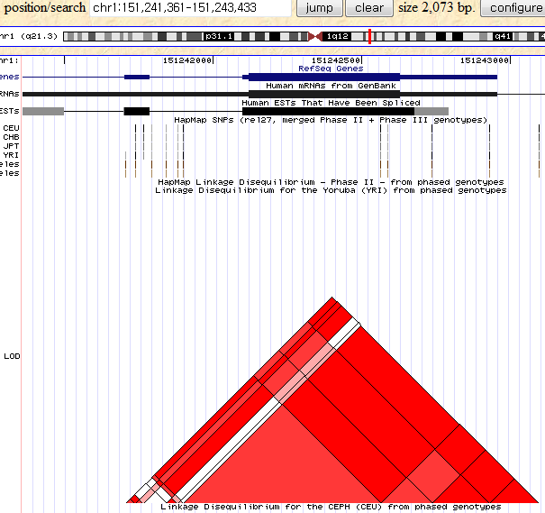

Slide 20
Tajima’s D
A measure of nucleotide diversity
Compare observed nucleotide against the expected diversity under the assumption that all polymorphisms are selectively neutral and constant population size.

Slide 21
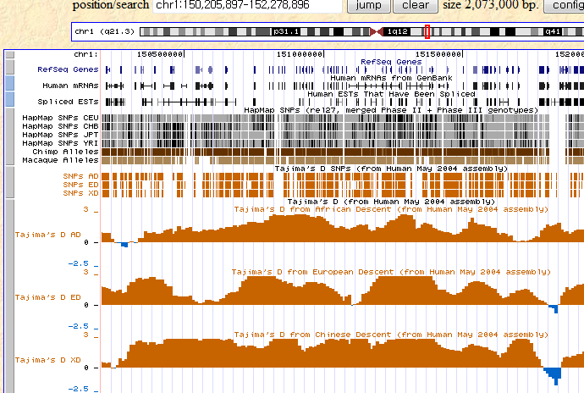

Slide 23
Database of Genomic Variants: Structural variation
Copy number variants, in-del, inversion, inversion breakpoint
Genomic variation observed healthy man
Genomic alteration that involve segments of DNA that are larger than 1kbp
copy number variants are orange, insertions/deletions are dark green and inversions/inversion breakpoints are red.

Slide 24
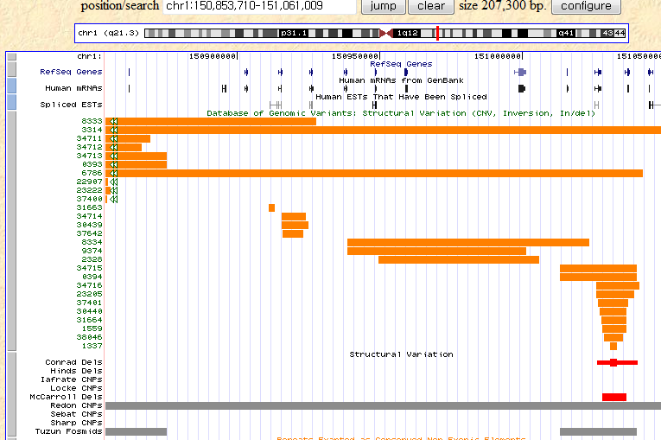

Slide 26
HGSV Discordant Clone End Alignments
Clone ends from 9 individuals
End mappings were discordant with the reference genome
  Deletion
  Insertion
  Inversion
  OEA
  transchrm

Slide 27
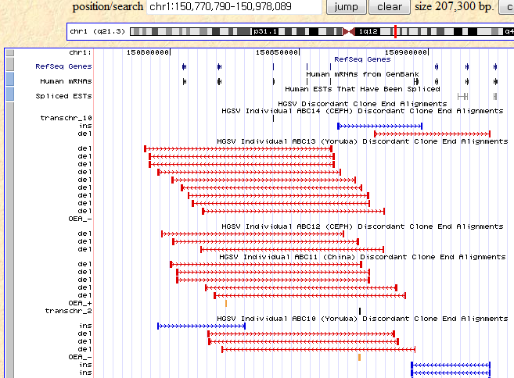

Slide 29
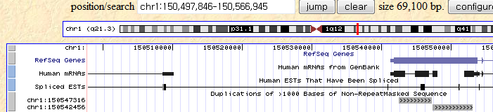
Duplications of >1000 Bases of
Non-RepeatMasked Sequence
Putative genome duplication within the golden path

Slide 31
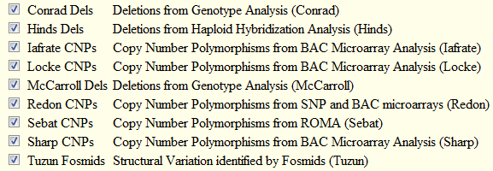
Structural variation

Slide 32
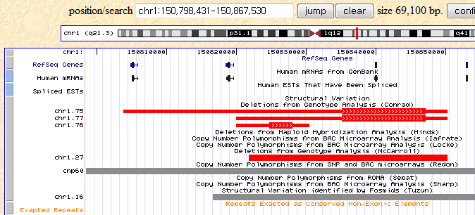

Slide 34
Repeats Exapted as Conserved Non Exonic Elements
Exaptation (Gould et at. 1982) : conserved non-exonic element that have been deposited by mobile elements
May act as distal transcriptional regulators for near by genes.
RepeatMasker → BLASTZ

Slide 35
RepeatMasker
RepBase database
구분
  SINE (include ALUs, 300bp 미만)
  LINE (Long Interspersed Nuclear Element)
  LTR (Long Terminal Repeat, retroposons)
  Simple repeats (Microsatellite)
  Low complexity repeats
  Satellite repeats
  RNA repeats
  Other repeats / Unknown

Slide 36
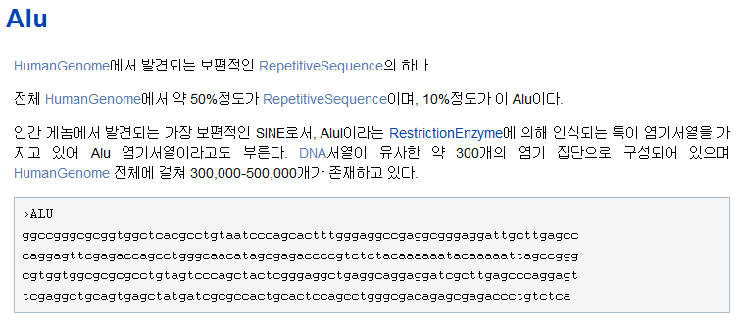

Slide 37
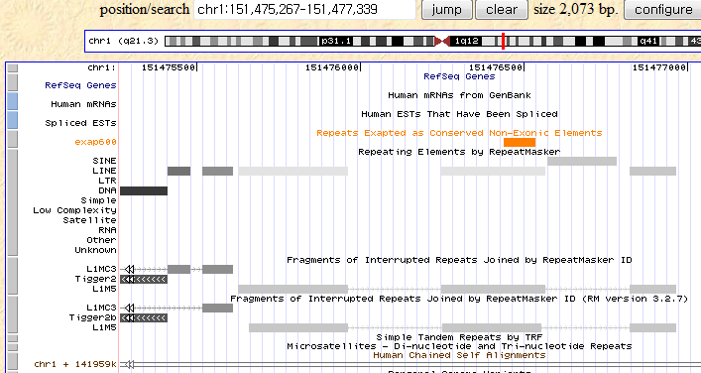

Slide 38
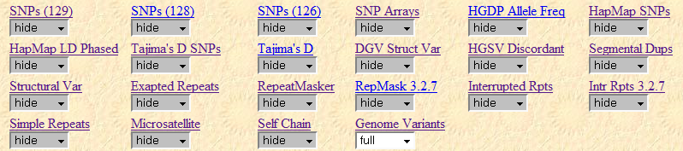

Slide 39
